Slide 1
Záróvizsga 5. csoport
13.B

Slide 2
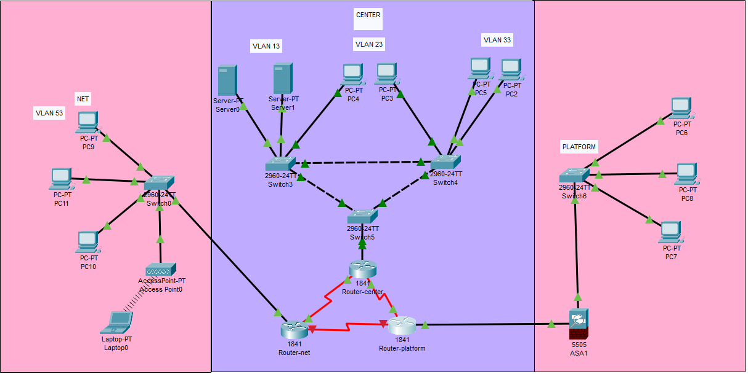
Project Introduction
We designed three sites for a medium sized company. The network supports all of the technical needs of the company.

Slide 3
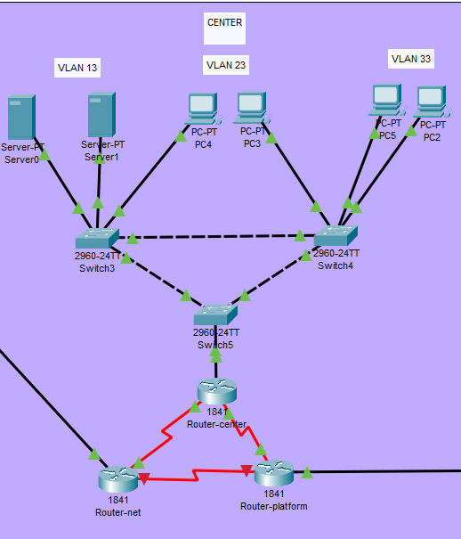
The Network
The network contains three sites:
The first location is the Center site – this would be the main center of the company.

Slide 4
VLANs at the Center location
We implemented a multi-level VLAN system. Three VLANs were created: VLAN 13, the administration VLAN, VLAN 23, the IT vlan, and VLAN 33, the guest network.
Redundant routers and switches were used.
Dynamic IPv4 addressing was implemented using DHCP on the router side.

Slide 5
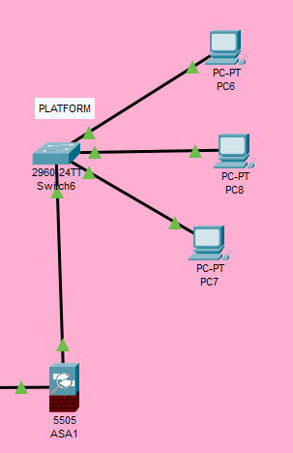
Platform site
The second location is the Platform side – this is the manufacturing and logistics site.

Slide 6
Site characteristics
This site contains a single VLAN: VLAN 43. This is the VLAN for the manufacturing process.
A Cisco ASA 5505 device serves as a hardware firewall.
Dynamic IPv4 addressing has been implemented at the site using DHCP on the router.

Slide 7
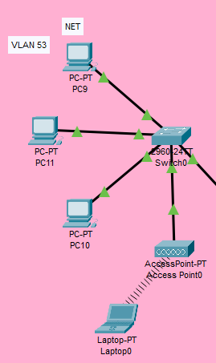
Net site
The third location is the Net side – this is the site for customer service and sales.

Slide 8
Site characteristics
Here is the sales VLAN – VLAN 53.
This site has a WLAN access point which provides wireless connectivity
A single device is connected to the wireless access point, the rest are connected to an ordinary switch using standard Ethernet cables.
Dynamic IPv4 addressing is also used here, just like at the other locations.

Slide 9
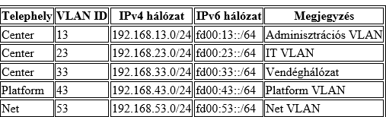
Network Addressing
Dynamic IPv4/6 addressing has been implemented at all sites. Multiple VLAN IDs have been assigned: three VLANs at the Center, and one at both the Platform and Net sites.

